Slide 1

Building a Safer Future
Through thorough data analysis of Construction-Related Accident Reports collected from the NYC Department of Building database.
By Roman Leshchinskiy

Slide 2


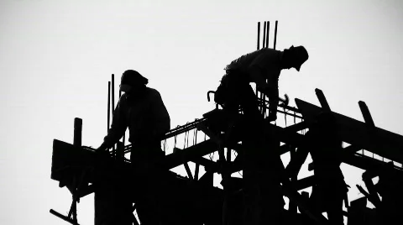
Importance of Safety in Construction
According to the U.S. Bureau of Labor Statistics (BLS):
Construction industry consistently ranks among the sectors with the highest fatality rates
Construction is the most dangerous job in NYC
5% of NYC total workforce is construction, but account for 27% of work-related deaths.

Slide 3
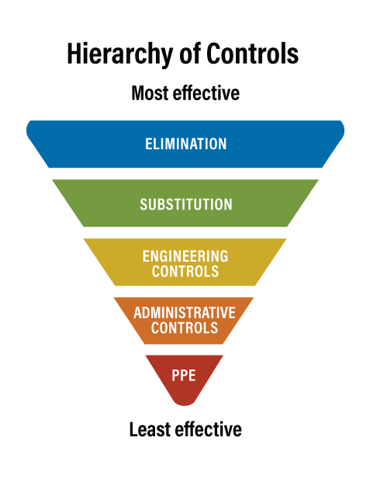

Understanding Safety
Physically remove the hazard
Replace the hazard
Engineer out the hazard
Change the way people work
Protect work with Personal Protective Equipment

Slide 4

Data:
DOB Construction Related Accident Reports
(Local Law 78)
Time Period:
January 2019 – September 2023
Attributes:
Incident Dates and Times
NYC Boroughs
Site Union Information
Employment Dates
Worker vs. Pedestrian Incidents
Injury and Fatality Counts
Disclaimer:
2020 September and December for unknown reason were not submitted

Slide 5




Do more experienced workers get injured less?
Which months had the most injured?
Which of the NYC boroughs had most injured?
What time of the day do the incidents happen more often?
Have the Injured/Fatal incidents been increasing or decreasing throughout the years?
Do non-Union get injured more than Union?

Slide 6
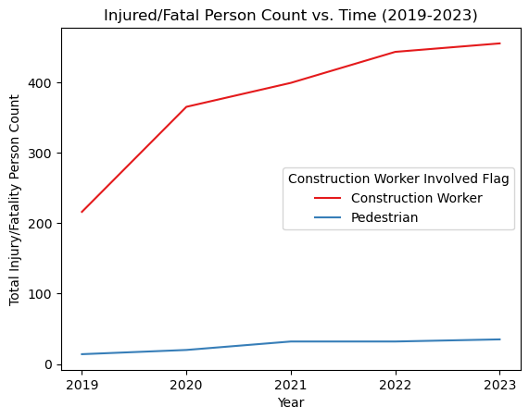
Have the Injured/Fatal incidents been increasing or decreasing throughout the years?
Graph Interpretations:
Injured workers AND pedestrians have gradually been increasing

Slide 7
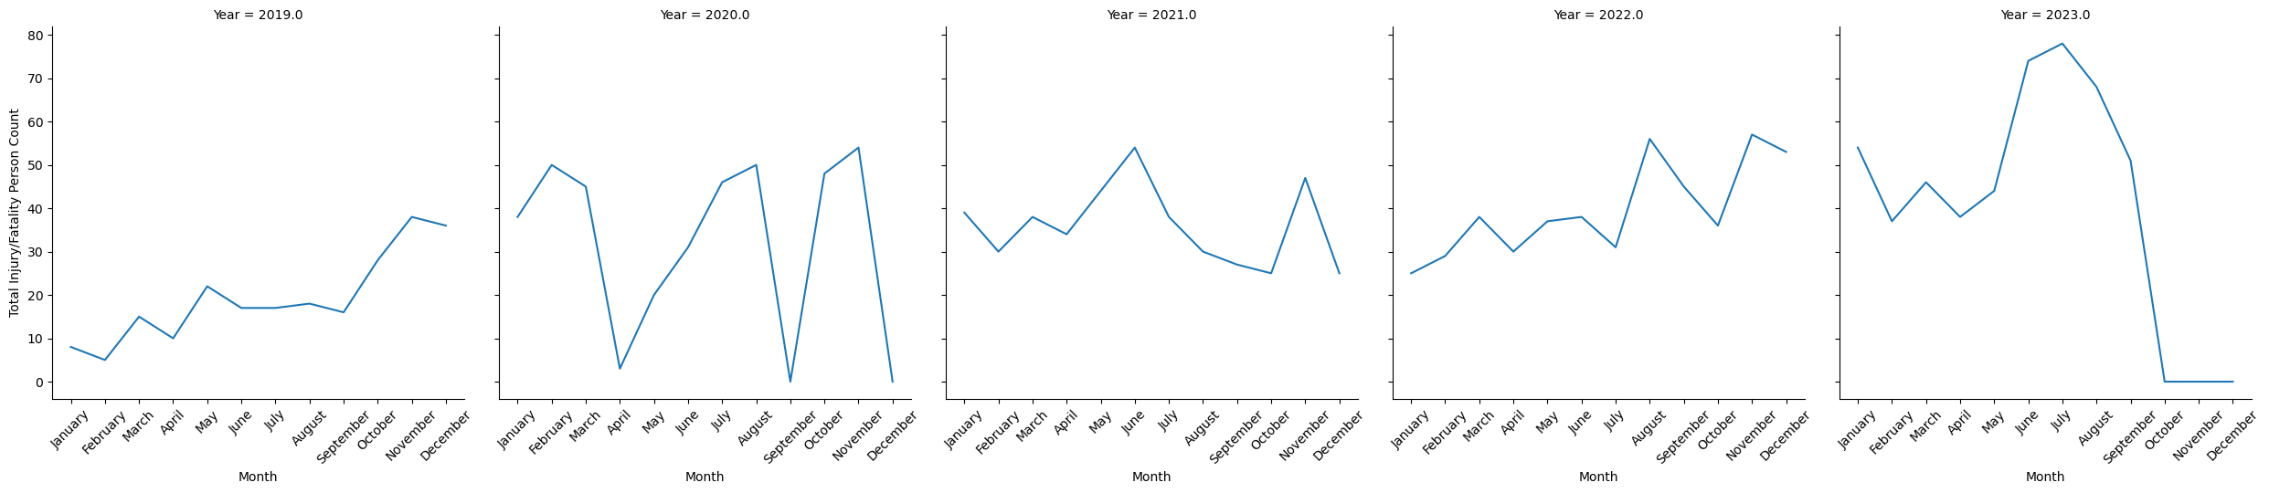
Peeks:
Summer Months: June, July August
End of Year Holiday Months, specifically November
Potential Explanation:
Summer heat adding a layer of hazard
Pressure to complete projects before the holidays
Which months had the most injured?

Slide 8
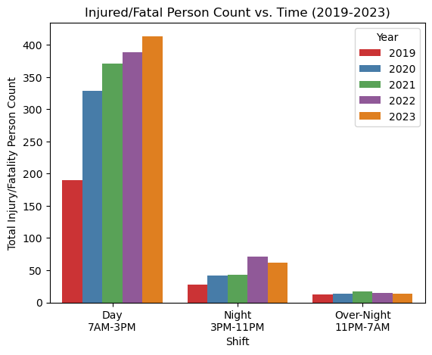
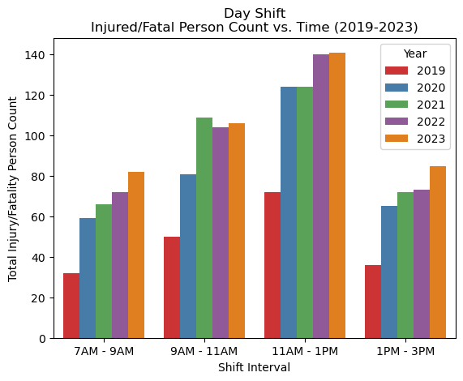
Most Injured Shift:
Day Shift
Graph Interpretation:
Within our shift analysis, we are also seeing a steady rise in injured, especially during the day shift.
11AM – 1PM is usually when workers are going lunch or coming back from lunch
Most Injured Shift Interval:
3rd Shift Interval (11AM – 1PM)
What time of the day do the incidents happen more often?

Slide 9
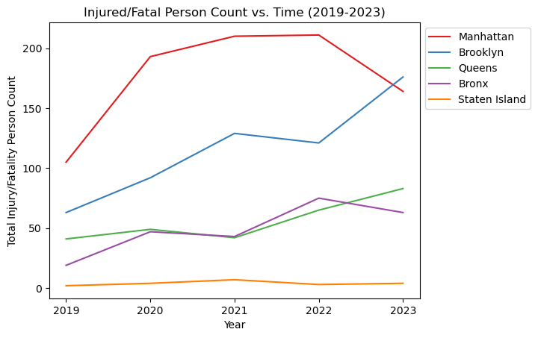
Graph Interpretation:
Most boroughs except for Staten Island have been increasing in injured.
Manhattan was seen a significant decrease in injured in 2023.
Which of the NYC boroughs had most injured?
Most Injured Borough:
Manhattan until 2019-2022
Brooklyn in 2023

Slide 10
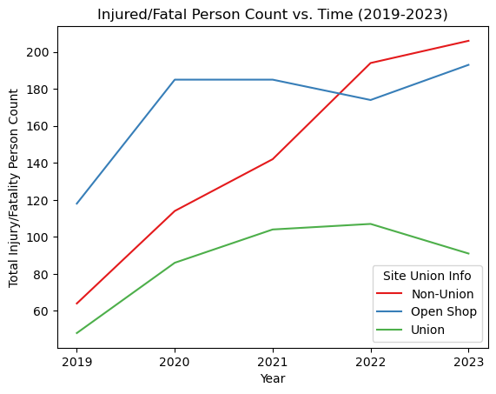
Most Injured by Union Info:
Non-Union sites
Graph Interpretations:
Union workers have gradually decreased in injured, while Non-Union has significantly been increasing.
Open Shop sites did have an increase in injured in 2020, like the other sites, but then leveled off
Do non-Union get injured more than Union?
Non-Union Site: a job that doesn’t employ unionized workers
Union Site: a job where union negotiates wages and benefits on behalf of the worker
Open Shop Site: a job that allows a combination of both Non-Union and Union workers

Slide 11
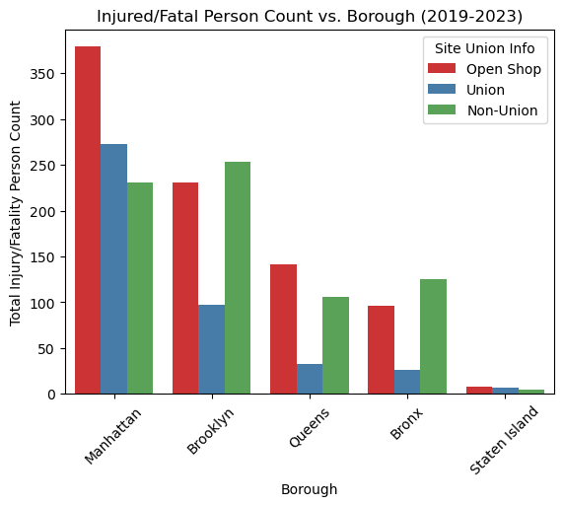
Do non-Union get injured more than Union ?
Most Injured by Union Info:
Manhattan has most injured in Open Shop and Union sites
Brooklyn has most injured in Non-Union sites
Non-Union Site: a job that doesn’t employ unionized workers
Union Site: a job where union negotiates wages and benefits on behalf of the worker
Open Shop Site: a job that allows a combination of both Non-Union and Union workers

Slide 12
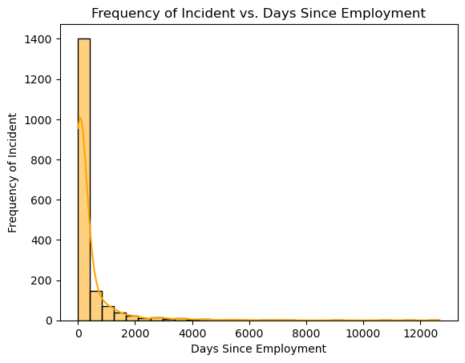
Do more experienced workers get injured less?
Graph Interpretations:
Experienced workers are injured less than newly employed workers
Majority of incidents occurs within the first 30 days of employment

Slide 13
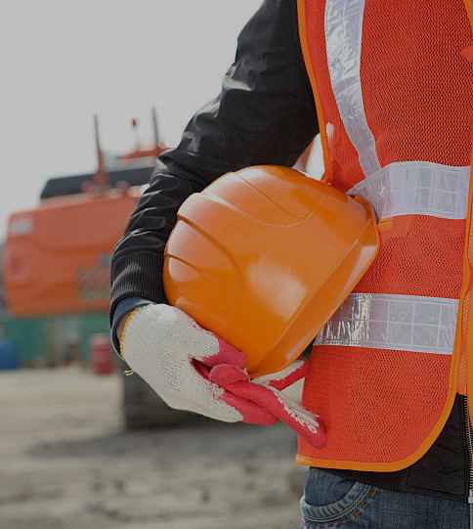
Summary Major Take Aways
Construction affects both workers and pedestrians in NYC, with incidents increasing annually.
Most incidents commonly occur during the summer months and November during the day shift from 11AM to 1PM.
Most affected boroughs of construction incidents are Manhattan and Brooklyn, with Brooklyn significantly increasing in injured over the last 5 years.
Open Shop and Union sites have more incidents in Manhattan, while Brooklyn has more Non-Union incidents.
Most incidents occur within the first 30 days of employment.

Slide 14
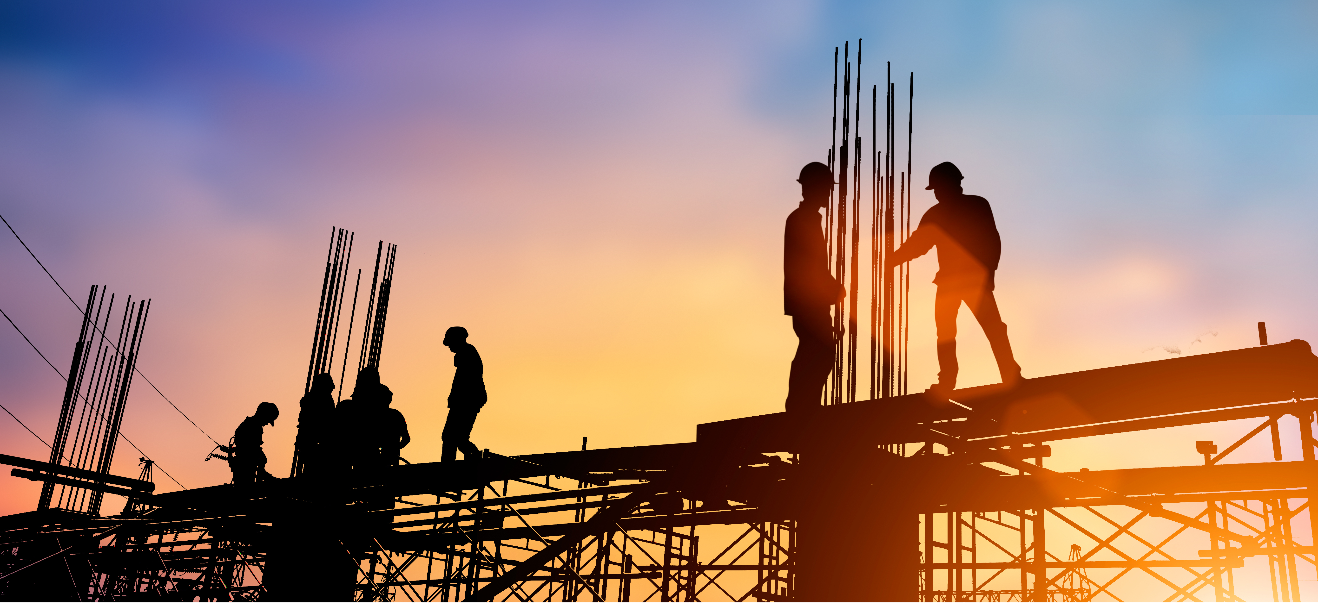
Optimistic Future Resolutions
Reforming definitions of a successful work ethic
Behavioral-Informed Safety Field Teams
Construction Schedules with emphasis on safety instead of production

Slide 15
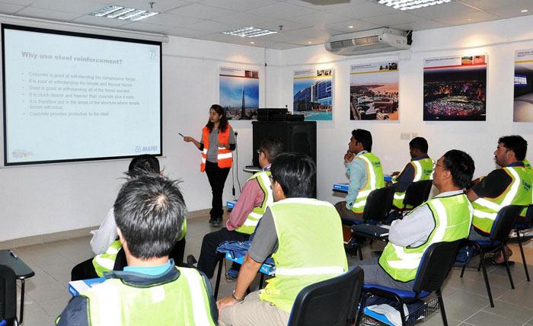
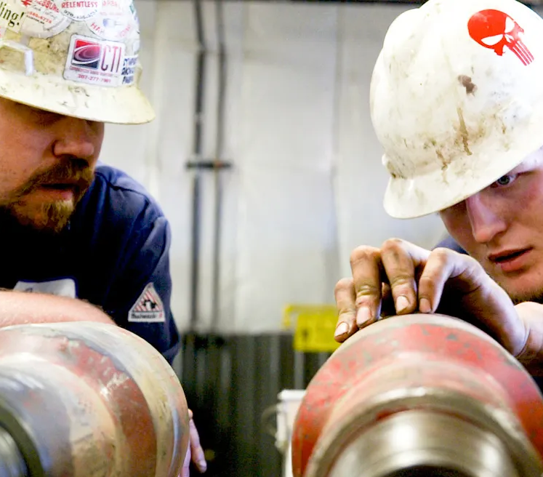
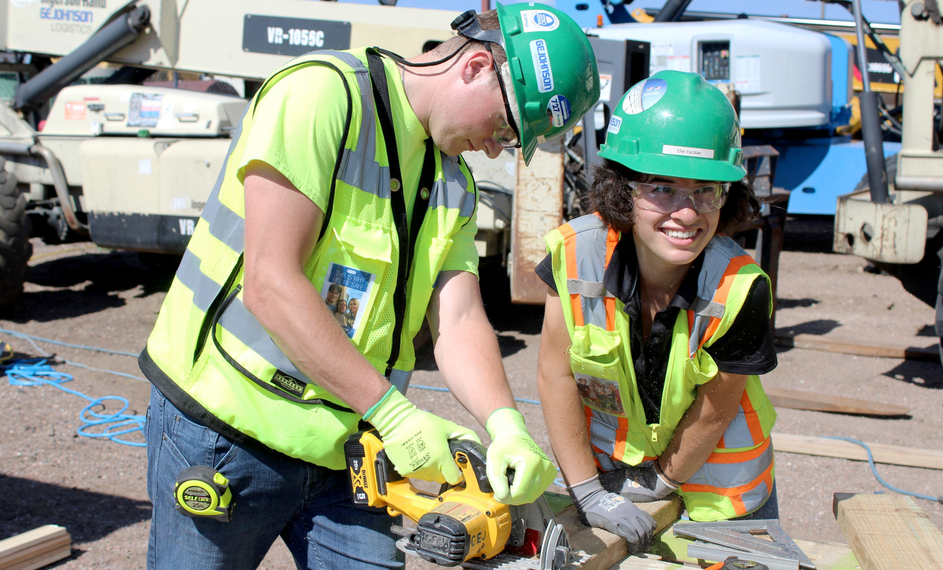

Optimistic Future Resolutions cont.
Leadership Shadowing:
3-month instructional period directly following employment
8-hour Shift:
4-hour lesson that reflects on best safety practices with specialized focus on trade
4-hour work shift under direct supervision of experienced tradesman

Slide 16


“Train Street” in Hanoi, Vietnam

